Slide 1

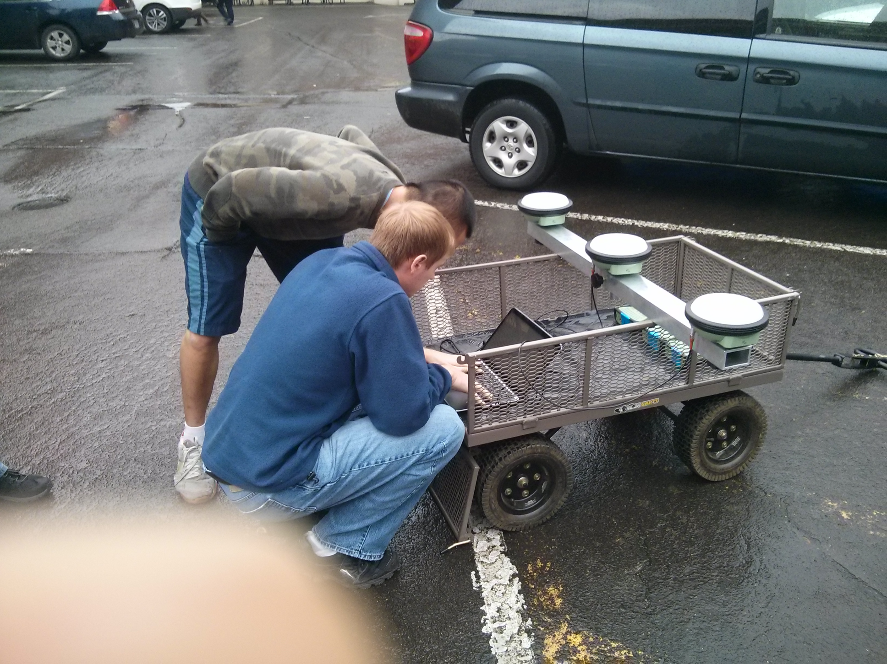
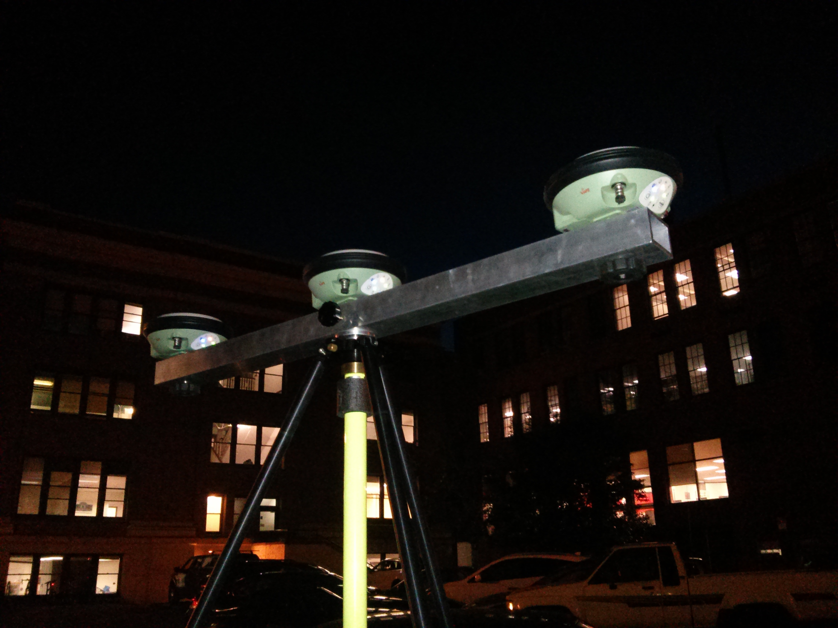
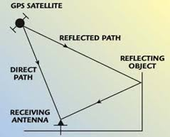
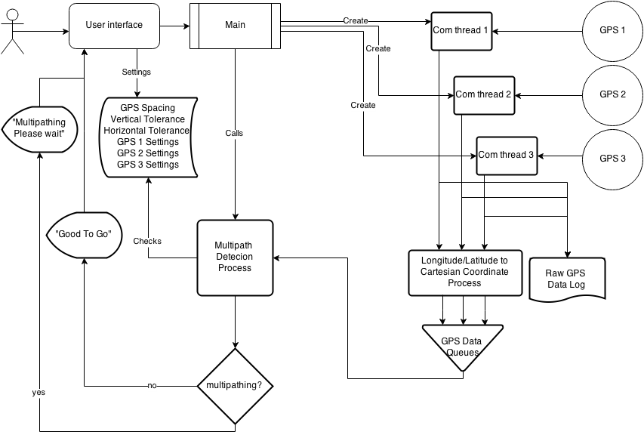
Oregon State University, College of Engineering
Trident GPS System
Albert Le, Nathan Christopher, Daniel Lin Tzu
Solving Multipathing one GPS at a time
Background
Surveyors work on the most precise level they are capable of. They use survey grade GPS receivers to receive data from active satellites in view. The common accuracy level is centimeters. A significant problem in quality of collected data occurs when obstructions, for example buildings or trees, nearby or overhead obstruct the line of site between the satellite and the GPS receiver.
These obstructions create potential for signal reflection, causing the GPS receiver to obtain an erroneous location. This phenomenon is termed multipathing by surveyors. This is a huge setback to surveyors because they set up their equipment, survey for hours on end, then process the data and recheck the position the next day. If multipathing occurs, they will need to recollect data.
Description
Instead of one GPS receiver, we use three. One main receiver and two to cross check the main.
Bullet
Bullet
Contact Info
Client:
Dr. Dan Gillins Ph.D., P.L.S.
Assistant Professor of Geomatics
School of Civil & Construction Engineering
Oregon State University
Dan.Gillins@oregonstate.edu
Team Members:
Albert Le leal@onid.oregonstate.edu
Nathan Christopher
Christon@onid.oregonstate.edu
Daniel Lin
Lintzu@onid.oregonstate.edu
Figure 2. Initial testing of GPS connection and parsing via USB
Figure 3. Trident GPS system, transmitting via Bluetooth to laptop
Results
Bullet
Bullet
Bullet
Bullet
Bullet
Figure 1. GPS signal reflects off of obstructions causing Multipathing
Figure 4. Trident Software Flow Diagram

